Slide 1
Making Good Choices
By Brooks Teachers

Slide 2
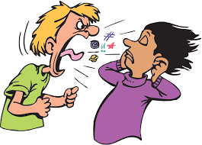
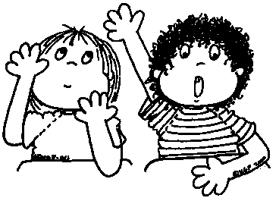
Which shows being respectful?
Raising your hand to speak
Yelling at someone to get their attention

Slide 3
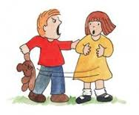
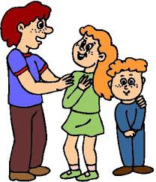
Which shows being respectful?
Grabbing from others
Offering to help others

Slide 4
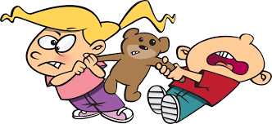
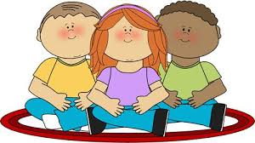
Which shows following directions?
Sitting with friends
Fighting with friends

Slide 5
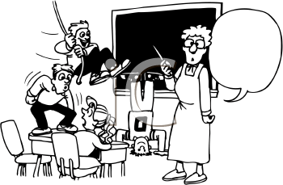
Which shows following directions?
Listen to the teacher.
Ignore the teacher

Slide 6
Which shows staying On Task
Completing your work
Playing with your pencil

Slide 7
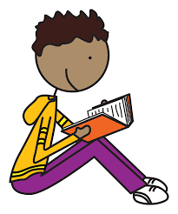
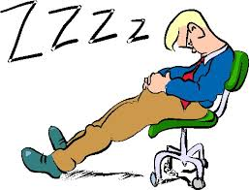
Which shows staying on task
Working at work times
Sleeping at work times

