Slide 1
Automatic Level I Drops
Stop and Think before you act or speak

Slide 2
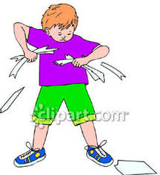
Destroying Property-breaking school’s or student’s things
Is not a good choice!
It makes friends mad!
This is a level 1 drop!

Slide 3
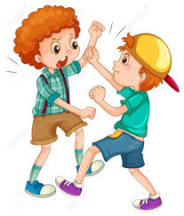
Physical Aggression
Physical Aggression- hitting, kicking, pushing, throwing, shoving
Can get someone hurt!
You will lose friends!
This is a level 1 drop!

Slide 4
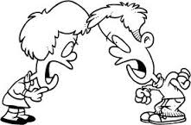
Verbal Aggression- cursing or threatening others
bbbbbCanCW
Notes:
This is a level 1 drop!

Slide 5
Leaving Assigned Area- running out of class or away from teacher
Isvvv
Notes:
This is a level 1 drop!

Slide 6
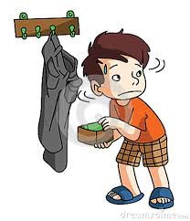
Stealing-Taking things that don’t belong to you
No one will trust you!
This is a level 1 drop!

